Slide 1

Dynamics in Soft, Biological and Disordered Systems
Nick Draper
Tessella
www.mantidproject.org

Slide 2
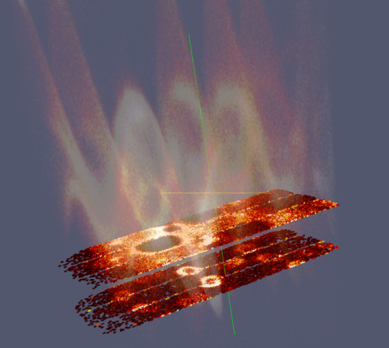
Overview
Mantid Introduction
Current development
Working with Mantid
Future directions

Slide 3

Project Goals
Goals
Consolidate the data reduction/analysis software for neutron scattering without restricting the needs of the instrument scientists
Key requirement
Create a Data Analysis framework
not instrument or technique/dependent
Cross-platform
Windows, Linux, Mac
Easily extensible
Freely redistributable

Slide 4
Project History
July 2007 Requirements & Design
April 2008 V 1.0 First instrument support
Feb 2010 V1.1 Support multiple techniques
April 2010 Collaboration with SNS & HFIR
Jan 2012 V2.0
Scientist validated results. VATES integration

Slide 5
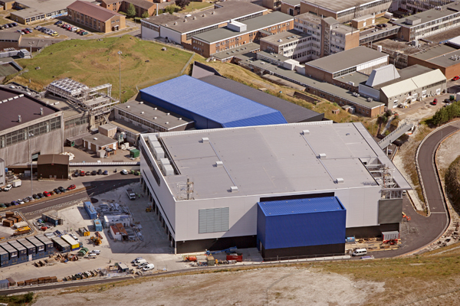
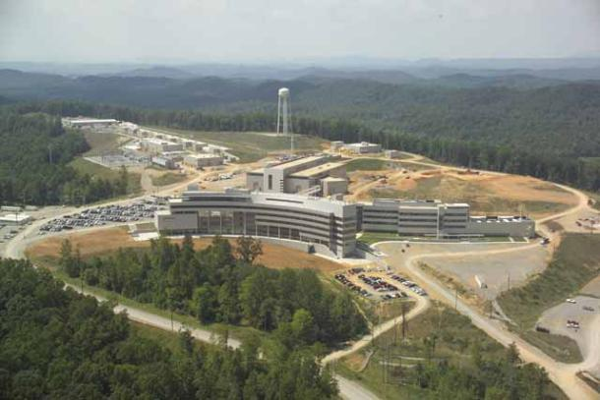
Project Organisation
ISIS
SNS/HIFR
Users
Scientific Steering Committee
Development Team
Users
Scientific Steering Committee
Development Team
Project Management Board

Slide 6
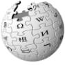

Continuous Integration Environment
Deploy to
Download site
Mantid Project Wiki
GitHub Repository
Automated System test
Build + unit test
-Linux (RHE & Ubuntu)
-Mac OSX
-Windows 32
-Windows 64
trac Issue
tracking
system
Developers

Slide 7
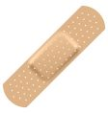
Releases
Development
Automated release
Daily
Full Release
Quarterly
Patch
2-4 weeks after a full release
Full release notes
Wide announcement
If system tests pass
Useful
Not stable
Full manual testing
Targeted testing
Low risk
Targeted improvements & fixes
Code review
Stable
Stable

Slide 8

Architectural Design - Overview
Instrument log files
Python
Command line & Scripting interface
Mantid Framework
RAW data files
API
Algorithms
Workspaces
MantidPlot Graphing and analysis
NEXUS data files
User Defined
User Defined
DAE direct access
Future Instrument specific UI
Future Instrument specific UI

Slide 9
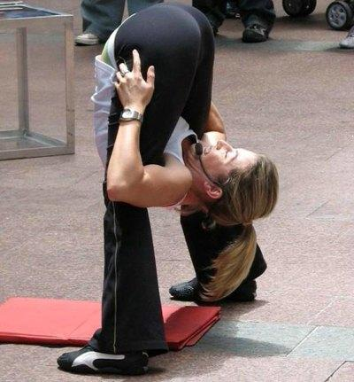
Framework flexibilty
Instrument independence
Virtual instrument defined
Loaded from xml definition
Location, rotation and shape of every pixel
Sample
Source
Technique independence
Algorithms
Unit Reduction and analysis steps
Workflow scripts / Algorithms
Chain algorithms to perform a reduction workflow

Slide 10
Plug in extensions
Algorithm Dialogs Custom Interfaces Custom Menus
Python scripts & libraries
Workflow Algorithms
Algorithms
Unit Conversions
Fit Functions Cost Models Constraints Minimizer
Workspaces
Archive Searching LiveData Listeners Data Catalogs
GUI
Framework
Utility

Slide 11
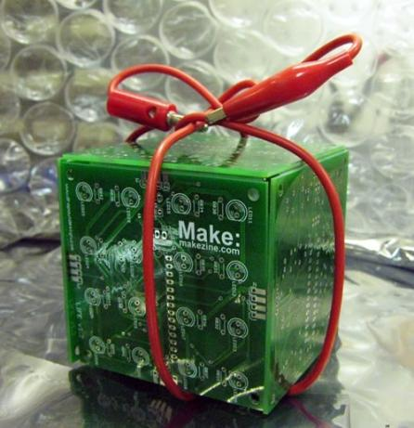
Open Source
GPL v3
Free to use
Source code openly available
Results cannot be sold
Unless you own the copyright
Good basis for collaboration
Sharing benefits to wider community
Why not LGPL, BSD etc?

Slide 12
Communication with us
Email
mantid-help@mantidproject.org
Instrument scientists
Scientific steering committee
Jon Taylor
Toby Perring
Project Website and documentation
www.mantidproject.org

Slide 13
What we can do - Algorithms
415
Arithmetic
Correction Functions
Absorption
Background
Efficiency
Technique
Single Crystal
Inelastic
SANS
Powder diffraction
Data handling
Diagnostics
Event Filtering
Optimization
Transforms
Masking
Grouping
Smoothing
Unit conversions

Slide 14
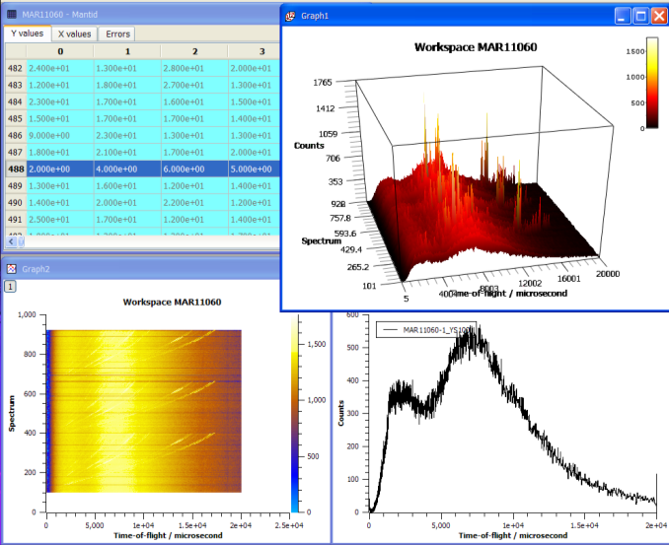
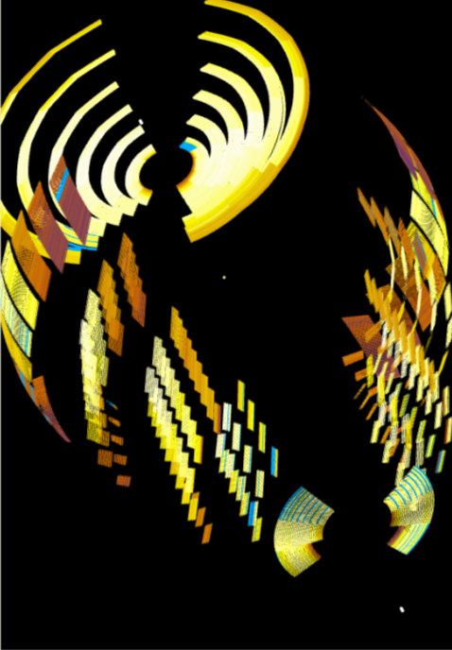
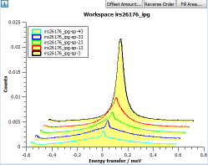
What can we do - Visualization

Slide 15
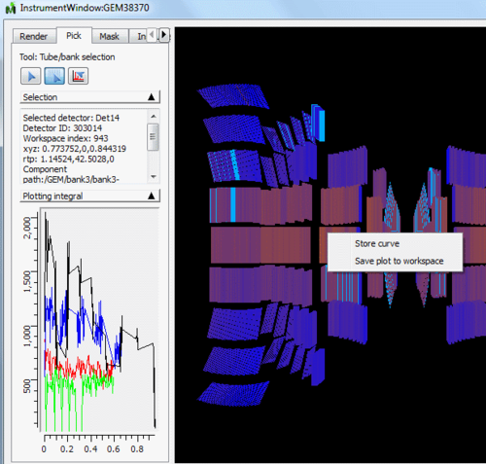
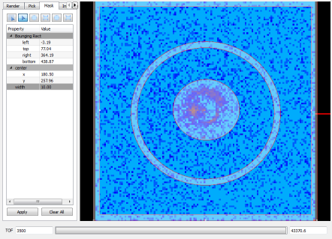
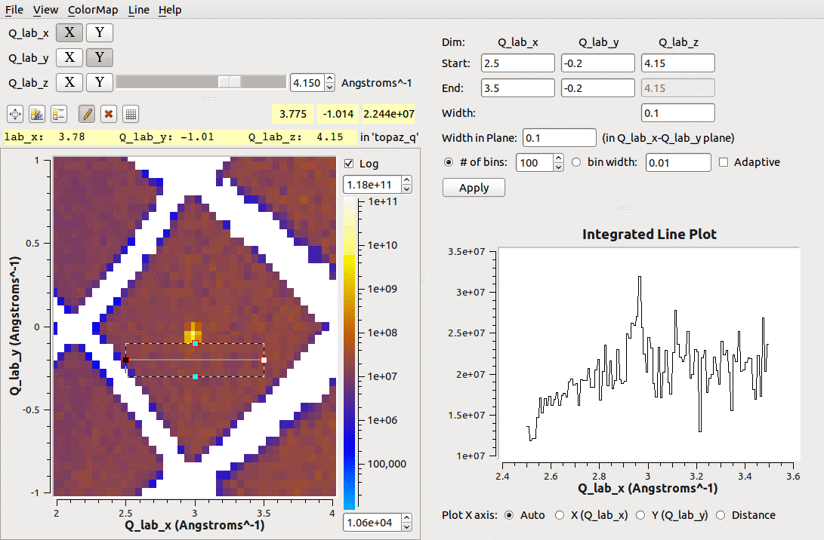
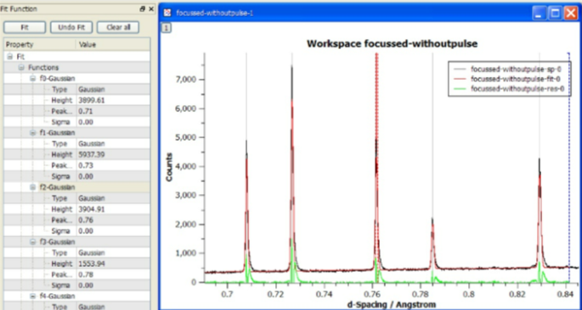
What we can do - Tools

Slide 16
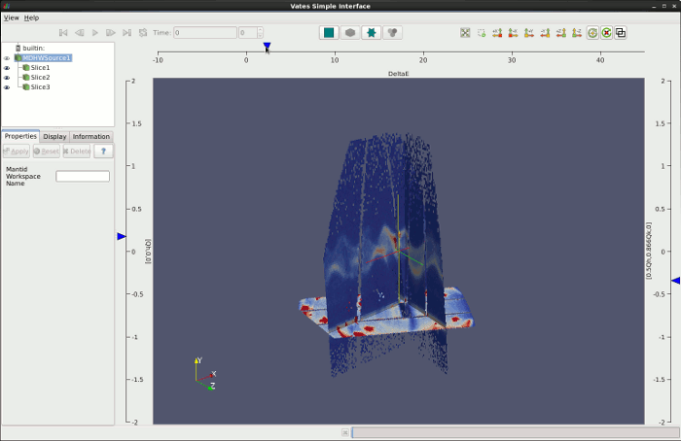
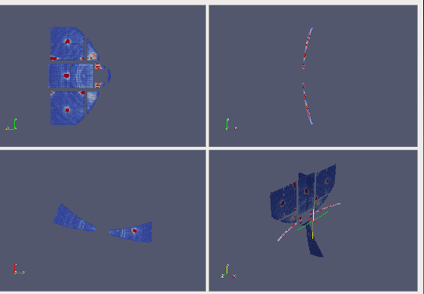
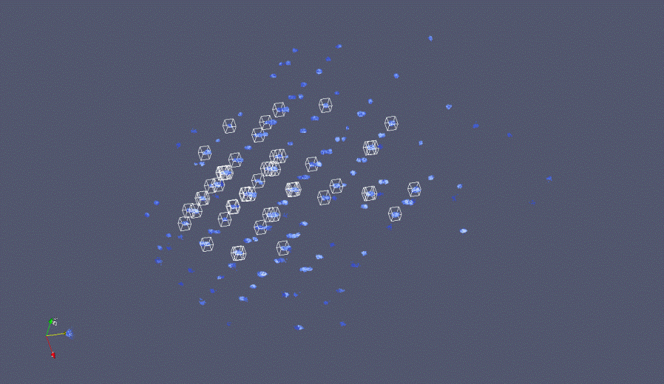

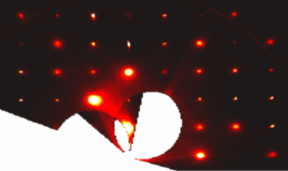
What can we do - Visualization

Slide 17
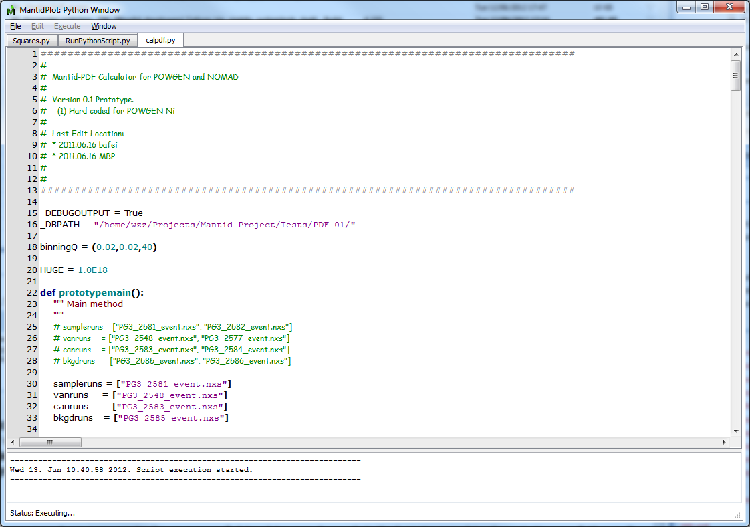
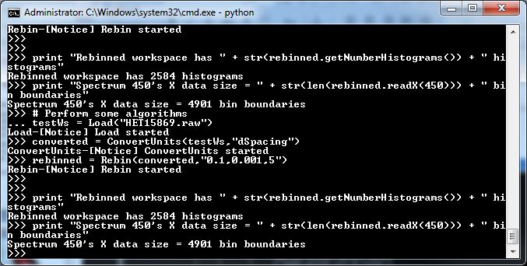
What we can do - Scripting
Python Control
Within Mantidplot
Pure Python scripts
Integrated numPy
Automated reduction

Slide 18
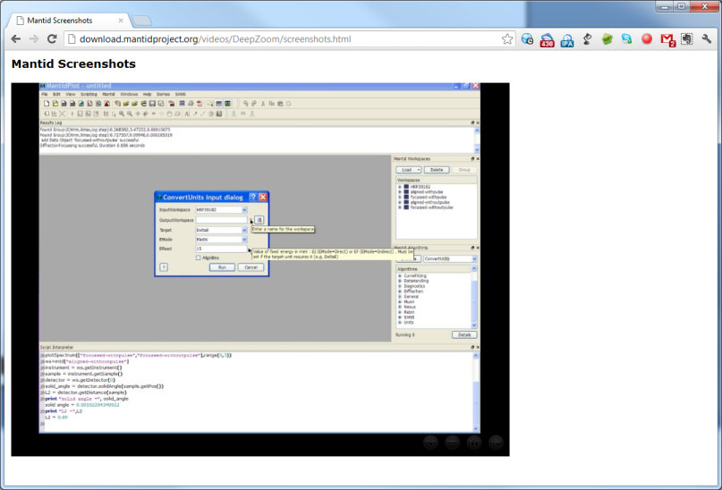
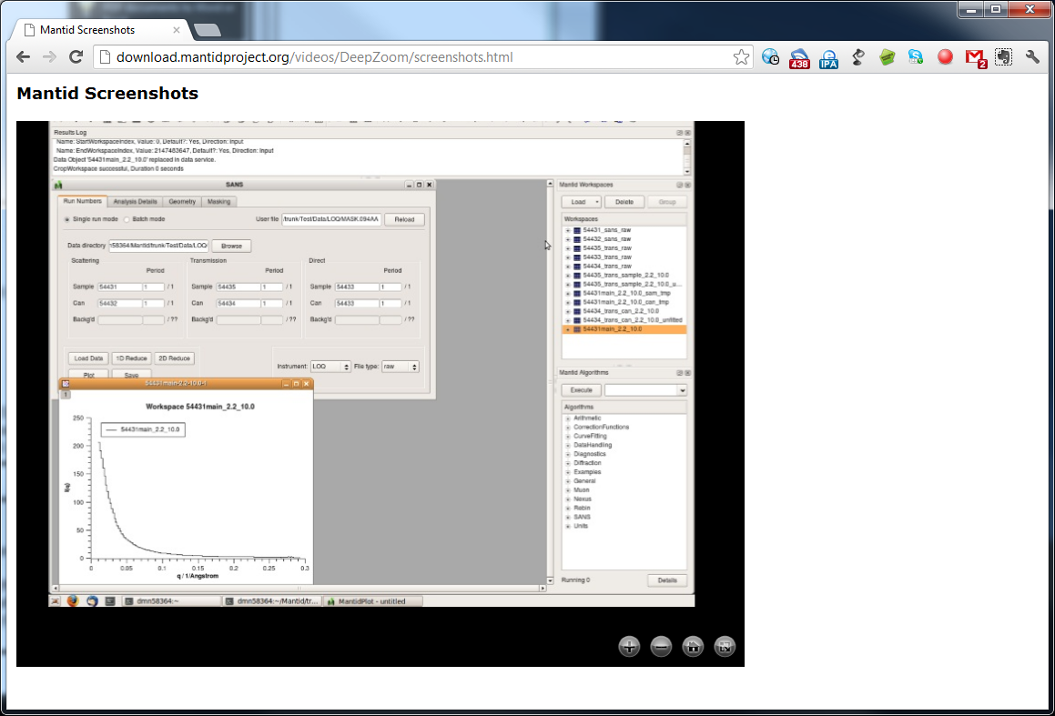
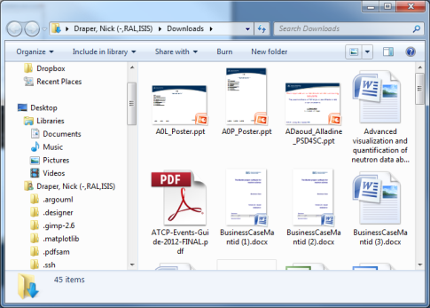
Ways of working with Mantid
Ad hoc Reduction
Task specific interfaces
Scripting
Automated Reduction

Slide 19
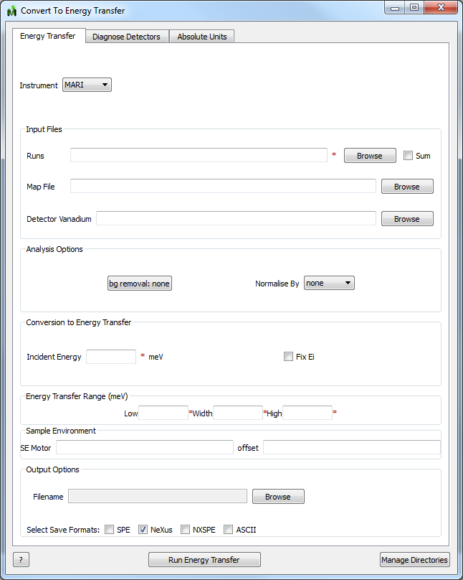
Analysing direct inelastic data
Convert To Energy Transfer
Easy to use first tab
Further detail out of the way
Detector Diagnosis
Absolute Units

Slide 20
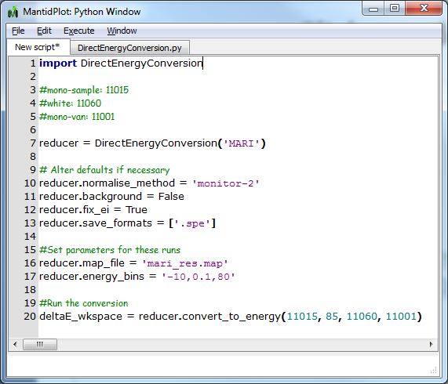
Analysing direct inelastic data
Scripting
Full access to all capabilities
More flexible
Faster for lists of runs
Ei

Slide 21
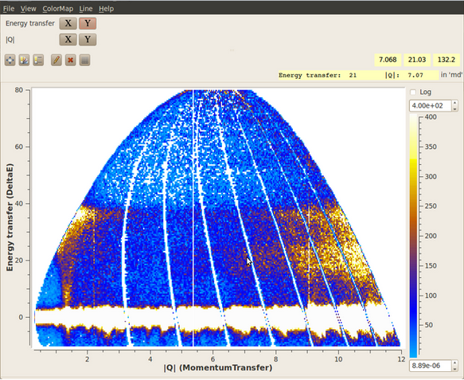
Beyond basic reduction
Convert to Energy Transfer
SofQW
ConvertToMD

Slide 22
Under development
Live event data reduction and analysis
Video 1080p 720p LowRes
Integration of data analysis with instrument control
PSD tube calibration within the Mantid framework
Multidimensional modelling, simulation and optimisation
Starting with Tobyfit functionality, but with more flexibility
Integration with ab-initio codes

Slide 23
Conclusion
Reduction - validated and robust
Advanced graphing and visualisation
Script or GUI, your choice
Please feedback your experiences, both bad and good
Active development and support is in place for the long term
mantid-help@mantidproject.org
www.mantidproject.org

